Slide 1

Introduction to Python - Part 7
User-defined Functions and Lambda Functions

Slide 2
User-Defined Functions (UDFs)

Slide 3
Built-in functions
The functions whose functionalities are pre-defined in Python are called as built-in functions
The Python interpreter has a number of functions built into it that are always available
Some of the examples of built-in functions are print(), input(), min(), max(), type(), etc.
We can defines functions according to our need as well. Such functions are called as built-in functions

Slide 4
User-defined functions
A function that a user defines is known as user defined function
A user can give any name to a user-defined function except that the function name should not have any special character including a space character
Any pre-defined Python keywords should not be used as function name
Note: You cannot use the Python keywords as function name

Slide 5
The def keyword
In python, a user-defined function’s declaration begins with the def keyword, followed by the function name
Keyword def marks the start of function header

Slide 6
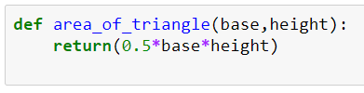
Defining the user-defined function
Step 1: Keyword def marks the start of the function header
Step 2: Provide a unique function name
Step 3 (optional): Provide parameters (arguments) by which we pass value to the function
Step 4: Add colon(:) to mark the end of the function header
Step 5: Write the necessary code. A function can be ended with or without a return statement
‘def’ keyword
function name
‘return’ keyword to return the computed value
Input parameters

Slide 7
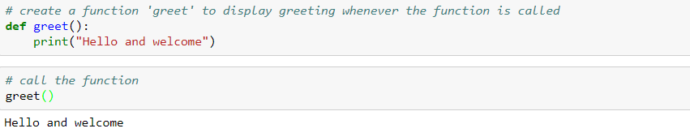
Write your own function

Slide 8
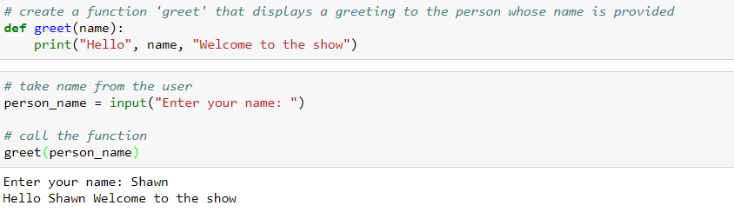
Write your own function with a parameter

Slide 9

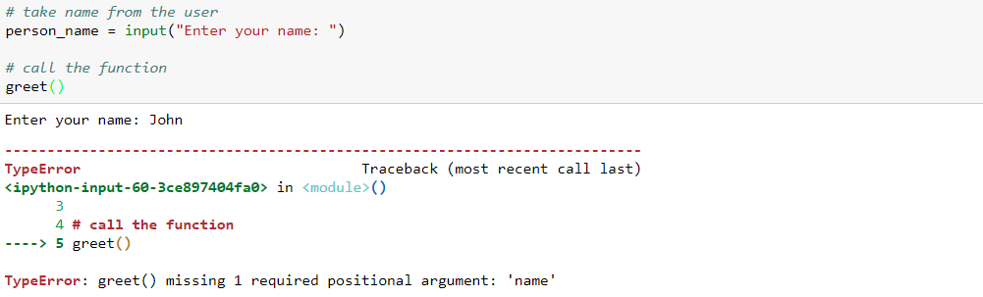
The function will throw an error if we do not pass the required parameter as per the function definition

Slide 10
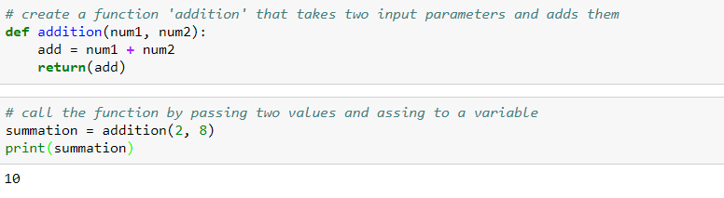
The ‘return’ keyword

Slide 11
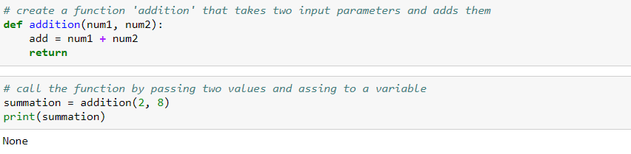
The function returns no value if we use return keyword in the function with any return value

Slide 12
Function Arguments

Slide 13
Function arguments
Required Arguments
Keyword Arguments
Default Arguments
Variable-Length Arguments

Slide 14
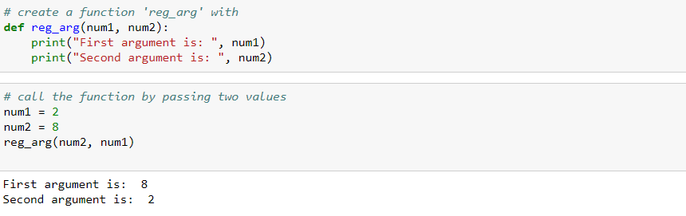
Required Arguments
Required arguments are the arguments passed to a function in correct positional order

Slide 15
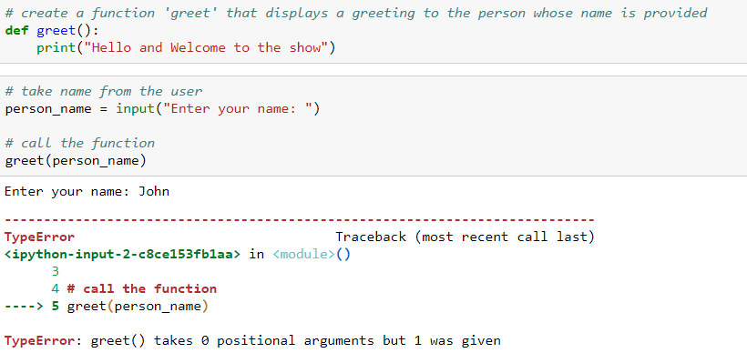
Required Arguments
In case, if the function does not requires the argument and is still passed it will throw an error

Slide 16
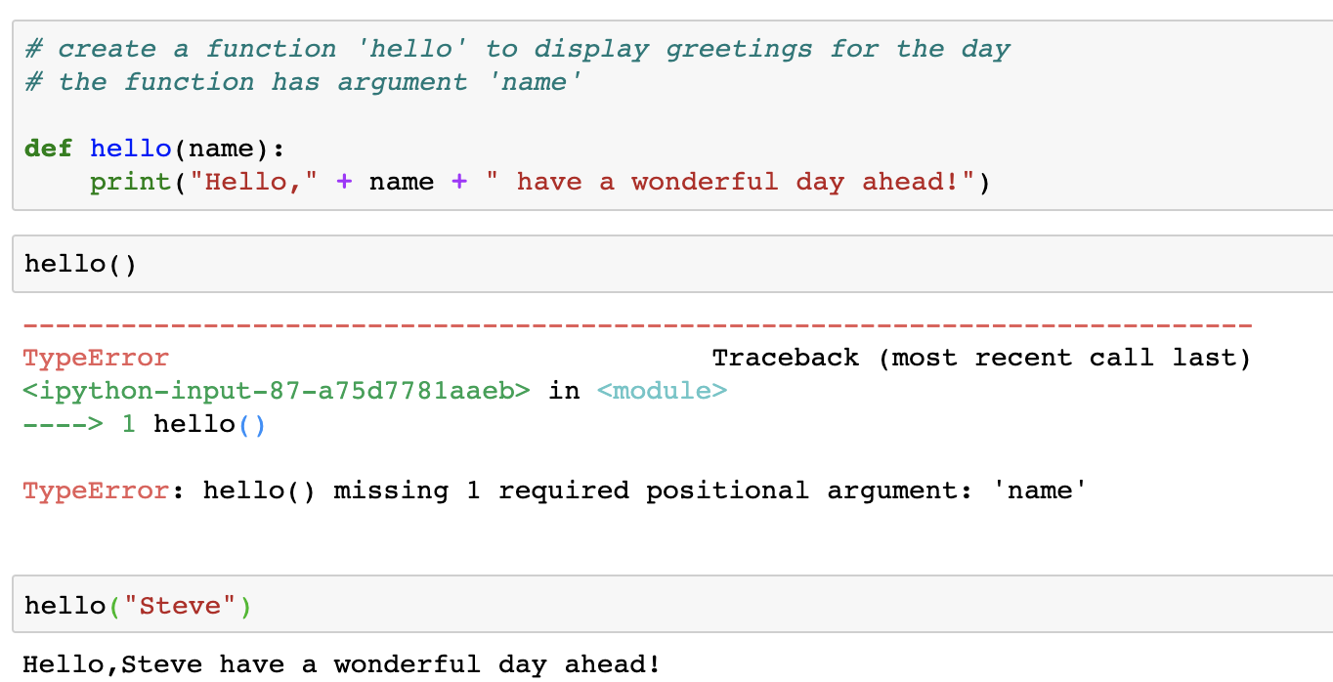
Required Arguments
In case, if the function requires the argument and is not passed it will throw an error

Slide 17
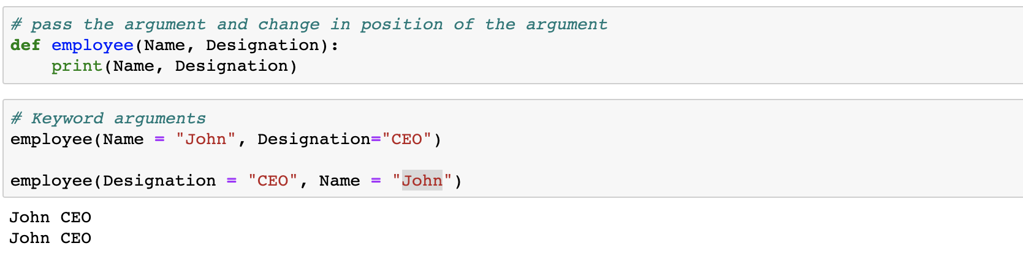
Keyword Arguments
When we call a function with some values, these values get assigned to the arguments according to their position
When we call functions in this way, the order (position) of the arguments can be changed
Such arguments are called as keyword arguments

Slide 18
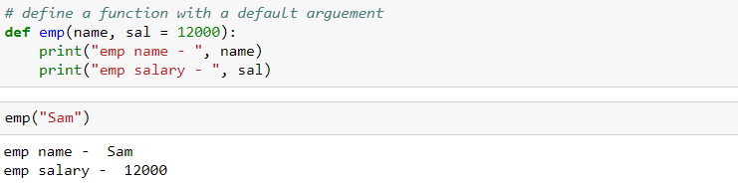
Default Arguments
A default argument is a value provided in a function declaration that is automatically assigned by the compiler if the caller of the function doesn't provide a value for the argument
We have passed a default value for salary in the function definition

Slide 19
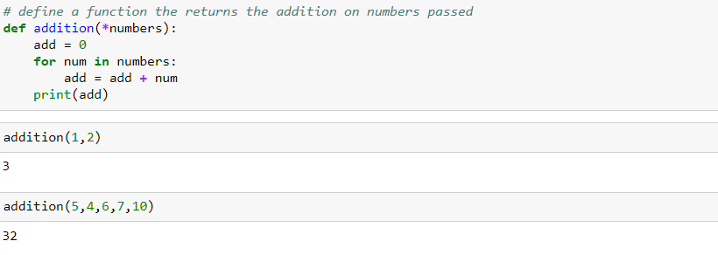
Variable-length arguments
Using *args helps you in passing variable number of arguments
This is especially helpful when you do not know how many arguments to pass to the function

Slide 20
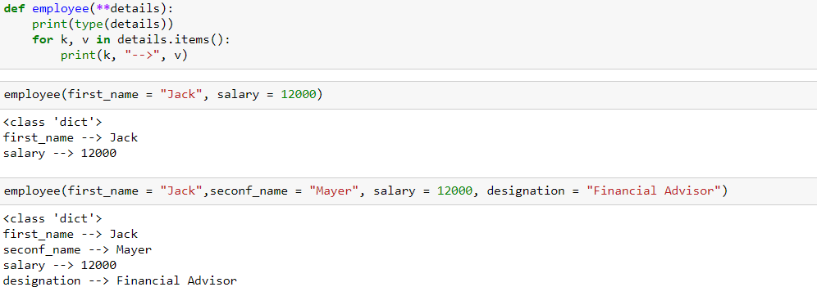
Variable-length keyworded arguments
**kwargs allows the users to pass keyword-ed arguments of variable length to a function

Slide 21
Lambda Function

Slide 22
Lambda function
Lambda functions are anonymous
They do not have any name
‘Lambda’ keyword to be used to create lambda function
Simple one-line function
No ‘def’ or ‘return’ keyword to be used with a lambda function

Slide 23
Lambda function
Every lambda function begins with the “lambda” keyword
A lambda function can have multiple arguments separated by commas
‘Lambda’ keyword to be used to create lambda function
A colon precedes the expression
The expression always returns an object

Slide 24
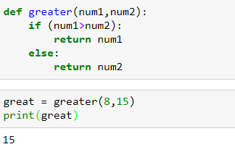

Lambda function
Python function code to find the greater number
Lambda function to find the greater number

Slide 25
Lambda with map()
map() functions expect a function_object, in our case a lambda function,and an iterable
It executes the function_object for each element in the sequence and returns a sequence of the elements modified by the function object
lambda expression
map(lambda_expression, sequence)
iterables such as list, tuples, etc.

Slide 26
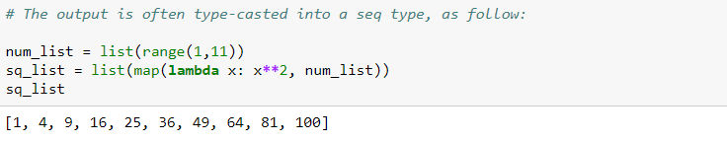
Lambda with map()

Slide 27
Lambda with filter()
The filter() function expects two arguments: function_object(lambda) and an iterable
Lambda expression returns a boolean value and is called for each element of the iterable
It returns only those elements for which the function_object returns true
lambda expression
filter(lambda_expression, sequence)
iterables such as list, tuples, etc.

Slide 28
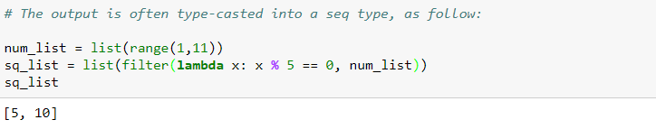

Lambda with filter()
Note : Unlike map(), the filter() function can have only one iterable as input.

Slide 29
Lambda with reduce()
The reduce() function in Python takes in a function and a sequence as argument.
The function is called with a lambda function and a sequence. A new reduced result is returned.
This performs a repetitive operation over the pairs of the sequence object.
lambda expression
reduce(lambda_expression, sequence)
iterables such as list, tuples, etc.

Slide 30
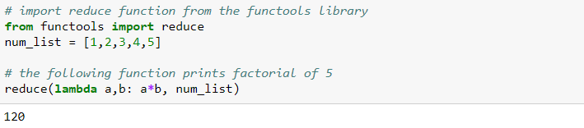
Lambda with reduce()
Determining the factorial of a number
1
2
3
4
5
Working:
2
6
24
120

Slide 31
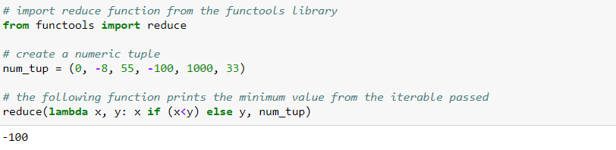
Lambda with reduce()
Determining the minimum of a numeric tuple of using reduce:
Note: reduce() can only have iterables of same type as input.

Slide 32
THANK YOU
Presenter’s Name
Contact Us
support@knowledgehut.com
Presenter’s Designation

